Slide 1
Multi layer perceptron

Slide 2
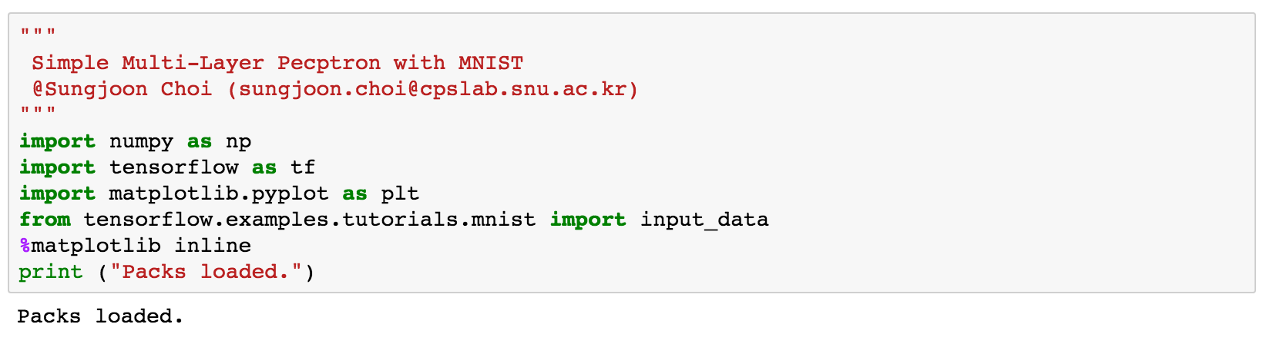
Import packages

Slide 3
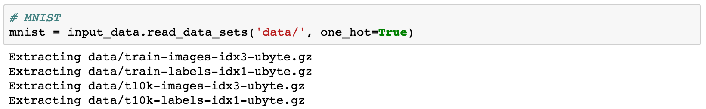
MNIST

Slide 4
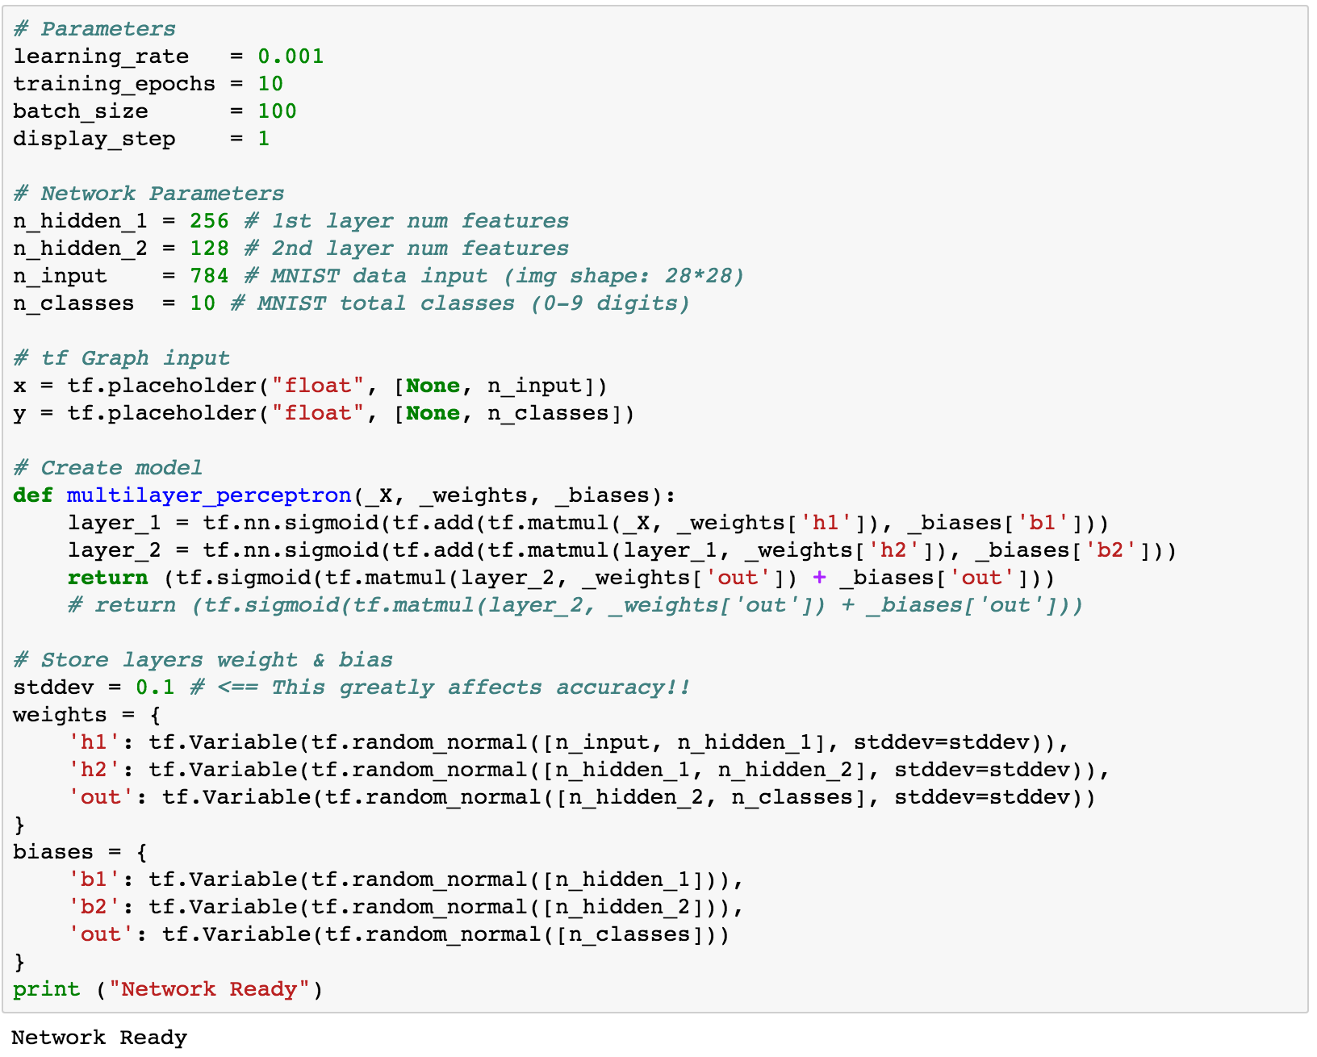
Tensor graph constructed

Slide 5
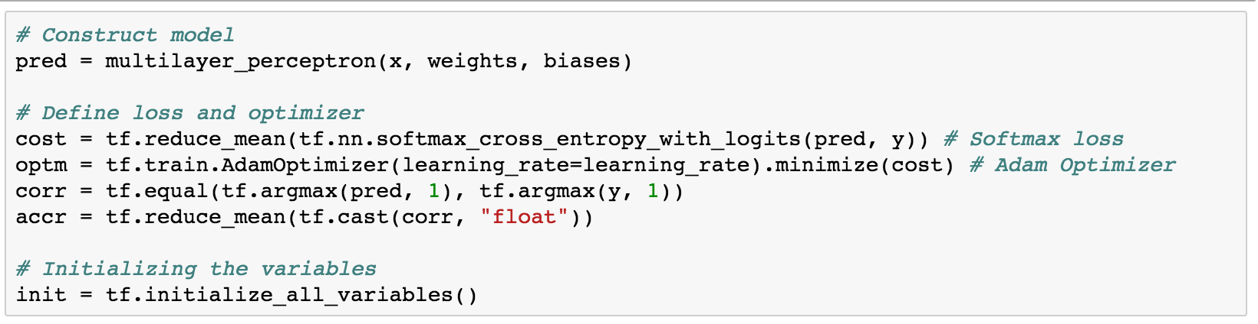
Functions

Slide 6
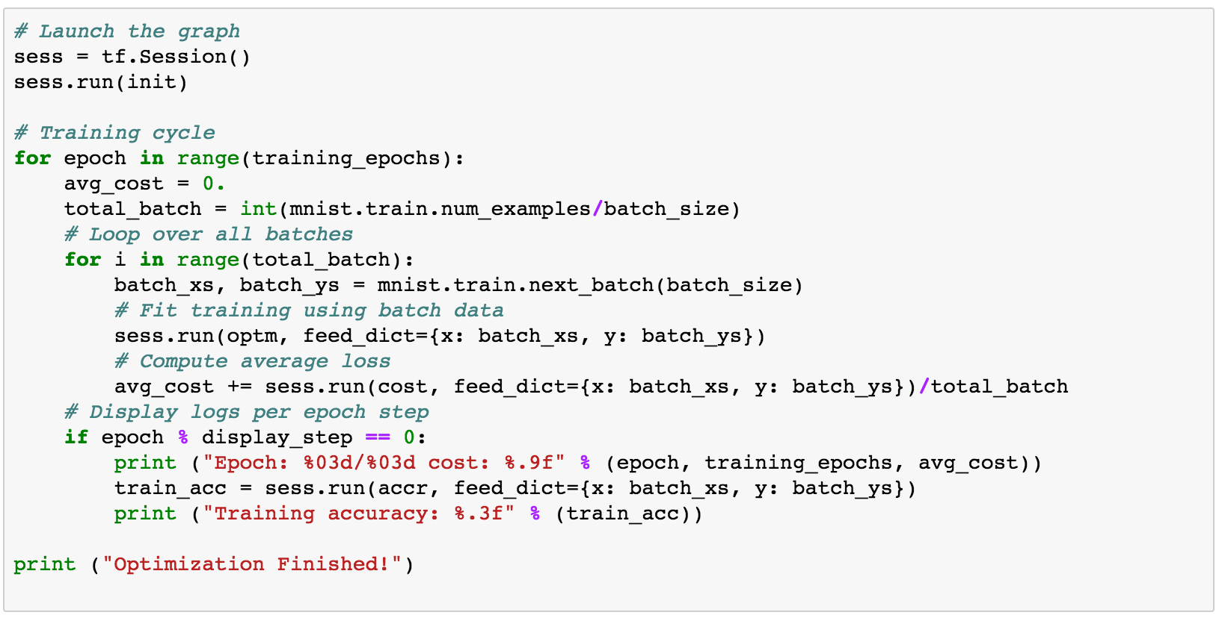
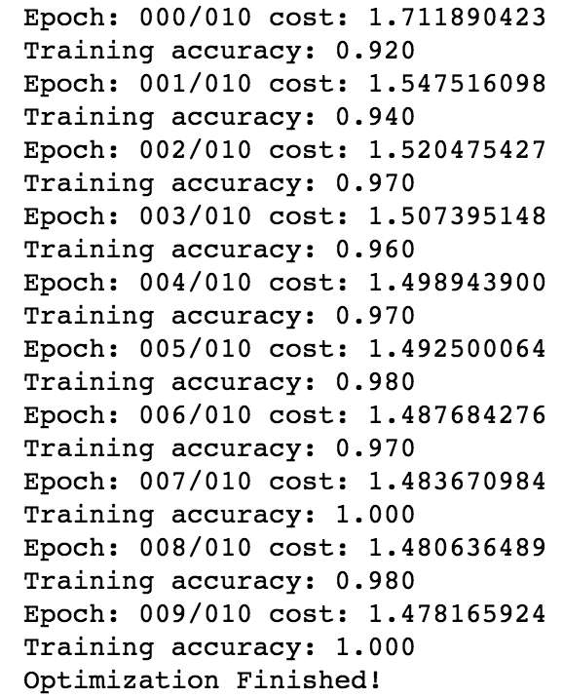
Run

Slide 7
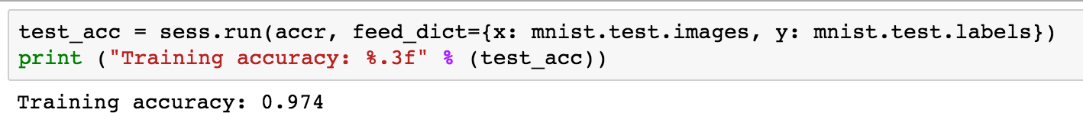
Test set accuracy

Slide 8
Further works
Add a third hidden layer!
Add dropout layers

